Slide 1
Long Range Satellite Communications
Prepared for SOCM/2
February 8 -10, 2012

Slide 2
Agenda
Long Range Satellite Communications – Overview
Long Range Communications – SATCOM
Long Range Communications – SATCOM
Enhancements
Impairments/Outages
Long Range Communications Performance
SATCOM ALL (CPDLC)
SATCOM I3 (CPDLC)
SATCOM I4 (CPDLC)
SATCOM ALL (ADS)
SATCOM I3 (ADS)
SATCOM I4 (ADS)
IRIDIUM (CPDLC)
IRIDIUM (ADS)
Common Maintenance Reporting Procedure

Slide 3
Long Range Satellite Communications - Overview
The following slides consist of performance for ARINC’s Long Range Communications Media.
Included are performance for both CPDLC and ADS from January 15, 2011– January 15, 2012.
The following categories are included in this presentation
SATCOM
IRIDIUM

Slide 4
Long Range Communications - SATCOM
The following slides show the performance for I3 & I4 SATCOM services as a whole and segregated.
Both CPDLC and ADS performance are included.

Slide 5
Long Range Communications – SATCOM Summary
Enhancements
I4 SATCOM fielded 4Q 2009
Several Inmarsat I4 SATCOM Software upgrades fielded in 2010 – 2011
ARINC ACARS system upgrade completed Aug 2011
Vizada I3 Upgrade at Santa Paula Jan 2012
Impairments/Outages
Several Telco hits
POR issue

Slide 6
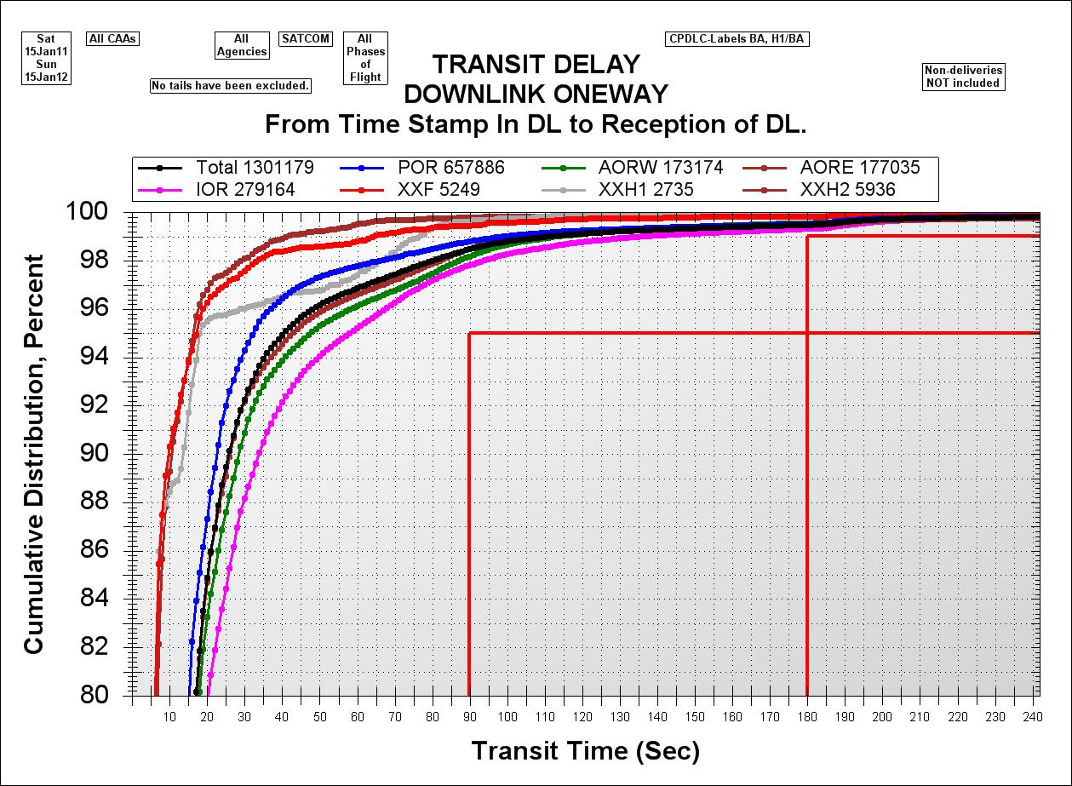
Long Range Communications – SATCOM All (CPDLC)
For both I3 and I4 networks. Delivery time is between the receipt of block and successful aircraft acknowledgement of block; includes time required for re-transmissions.
Performance > Goal of delivering 95% of first block of message within 60secs

Slide 7
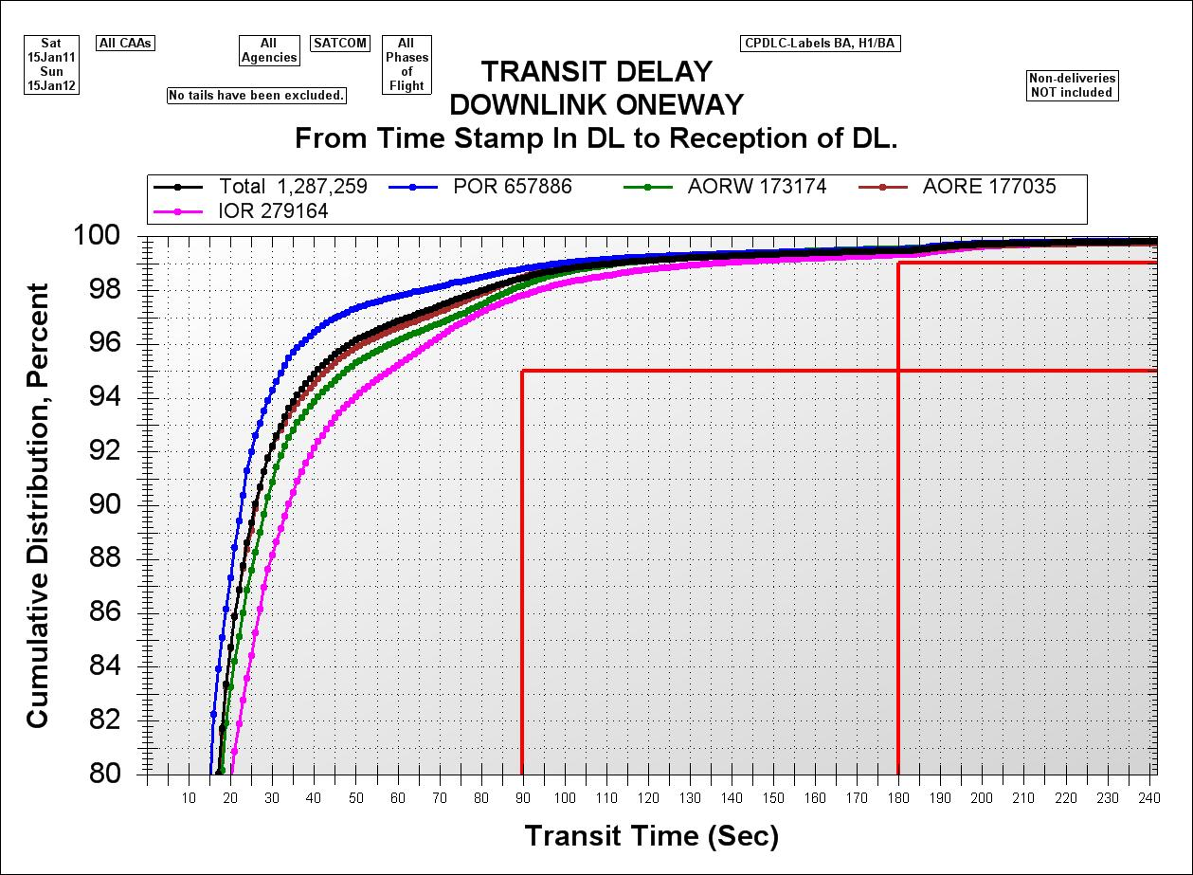
Long Range Communications – SATCOM I3 (CPDLC)
For I3 network. Delivery time is between the receipt of block and successful aircraft acknowledgement of block; includes time required for re-transmissions.
Performance > Goal of delivering 95% of first block of message within 60secs

Slide 8
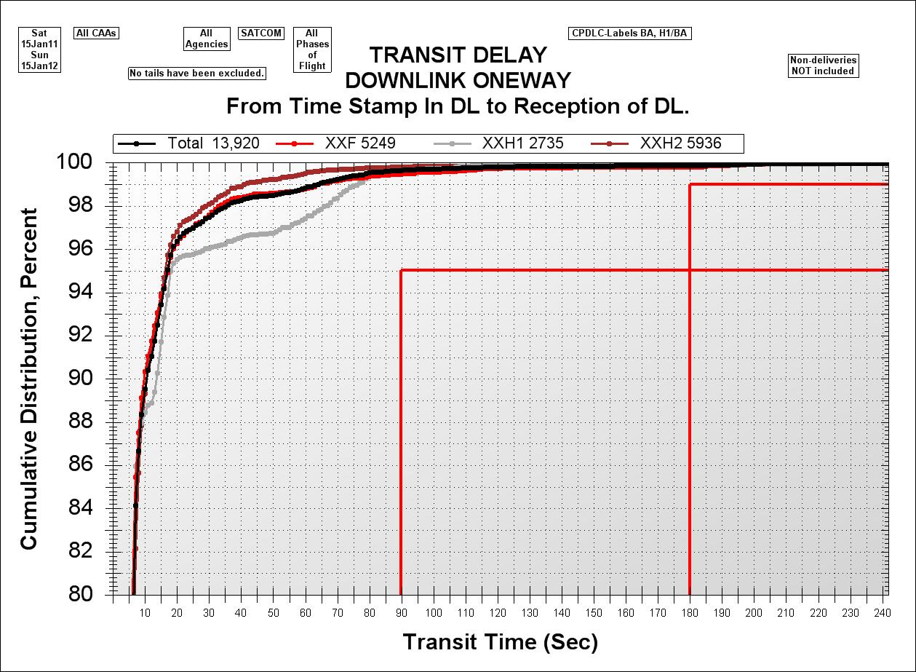
Long Range Communications – SATCOM I4 (CPDLC)
For I4 network. Delivery time is between the receipt of block and successful aircraft acknowledgement of block; includes time required for re-transmissions.
Performance > Goal of delivering 95% of first block of message within 60secs

Slide 9
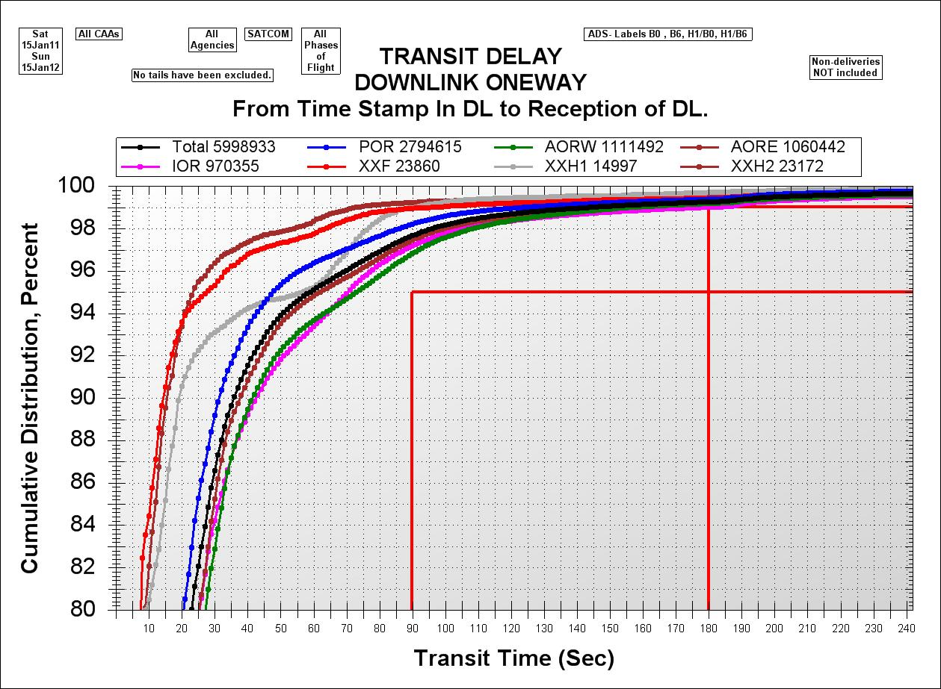
Long Range Communications – SATCOM All (ADS)
For both I3 and I4 network. Delivery time is between the receipt of block and successful aircraft acknowledgement of block; includes time required for re-transmissions.
Performance > Goal of delivering 95% of first block of message within 60secs

Slide 10
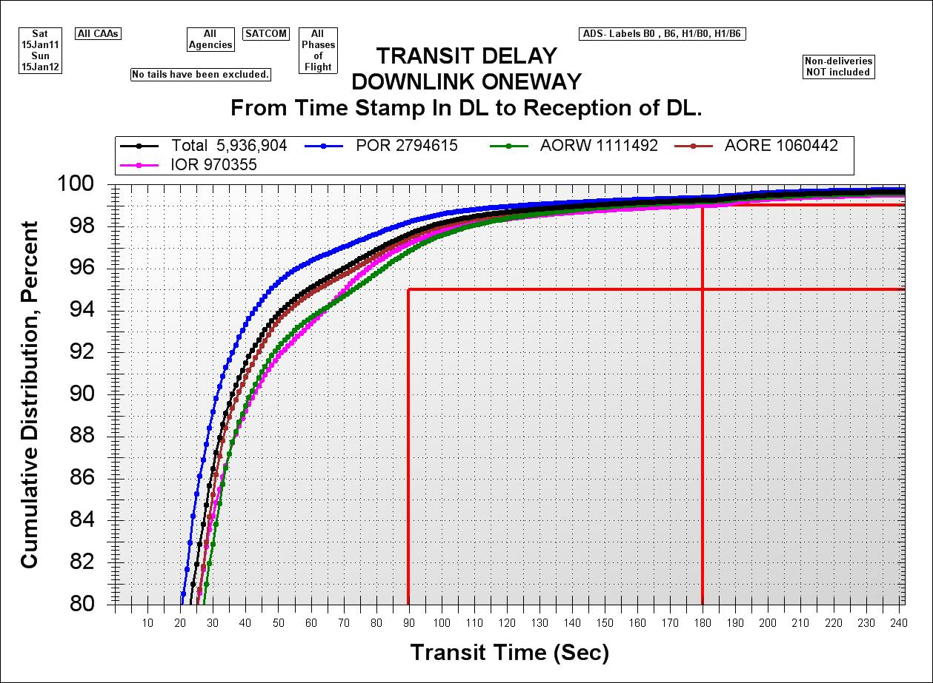
Long Range Communications – SATCOM I3 (ADS)
For I3 network. Delivery time is between the receipt of block and successful aircraft acknowledgement of block; includes time required for re-transmissions.

Slide 11
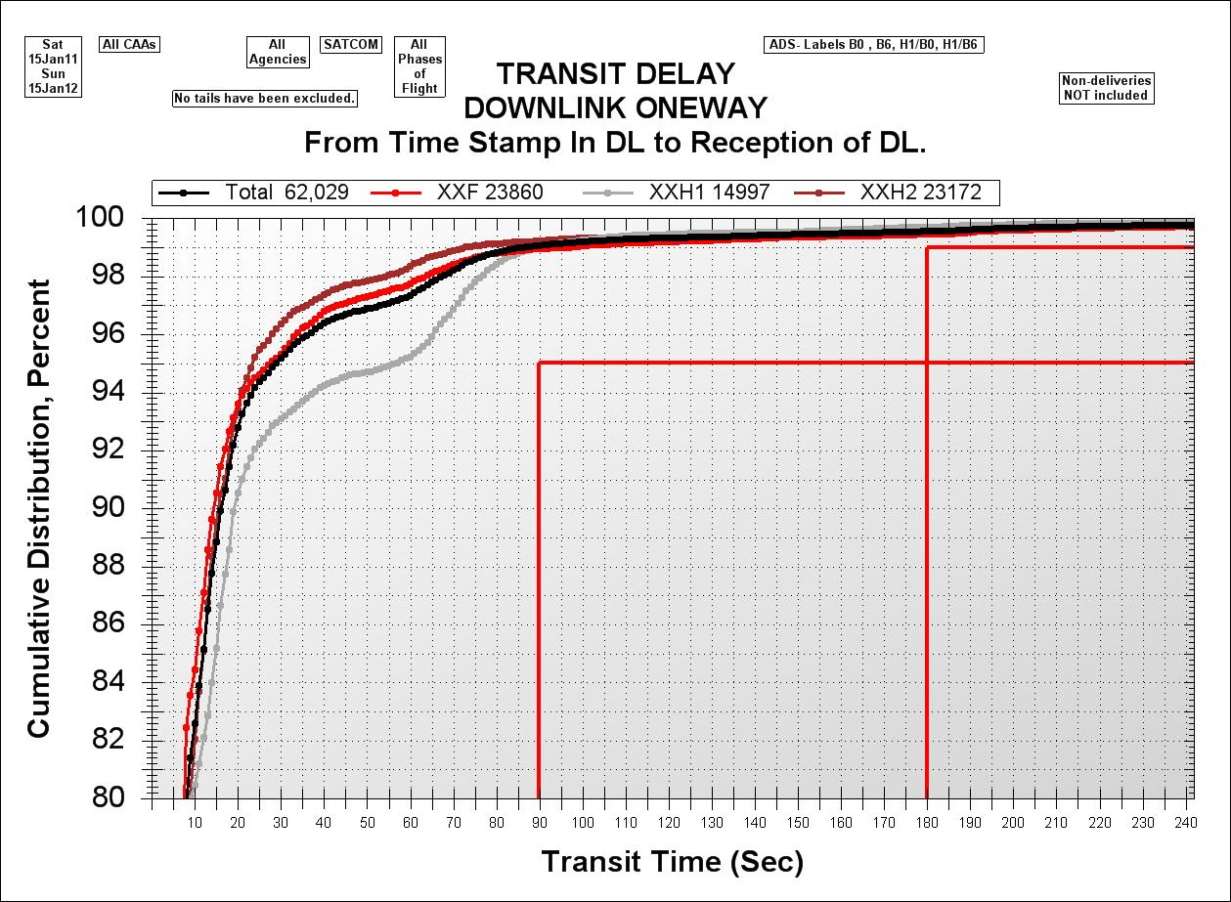
Long Range Communications – SATCOM I4 (ADS)
For I4 network. Delivery time is between the receipt of block and successful aircraft acknowledgement of block; includes time required for re-transmissions.

Slide 12
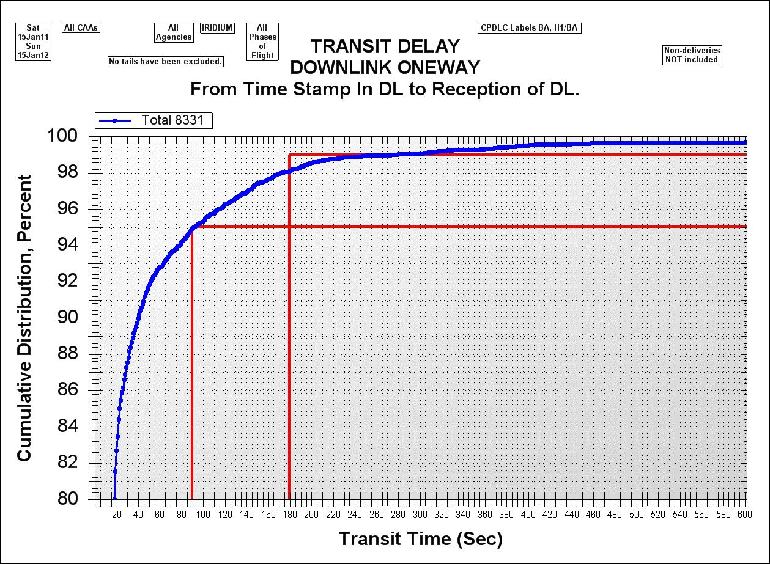
Long Range Communications – IRIDIUM (CPDLC)
Compared to the SATCOM services of I3 & I4, the data set is very small for the January 15, 2011 - January 15, 2012 time period.

Slide 13
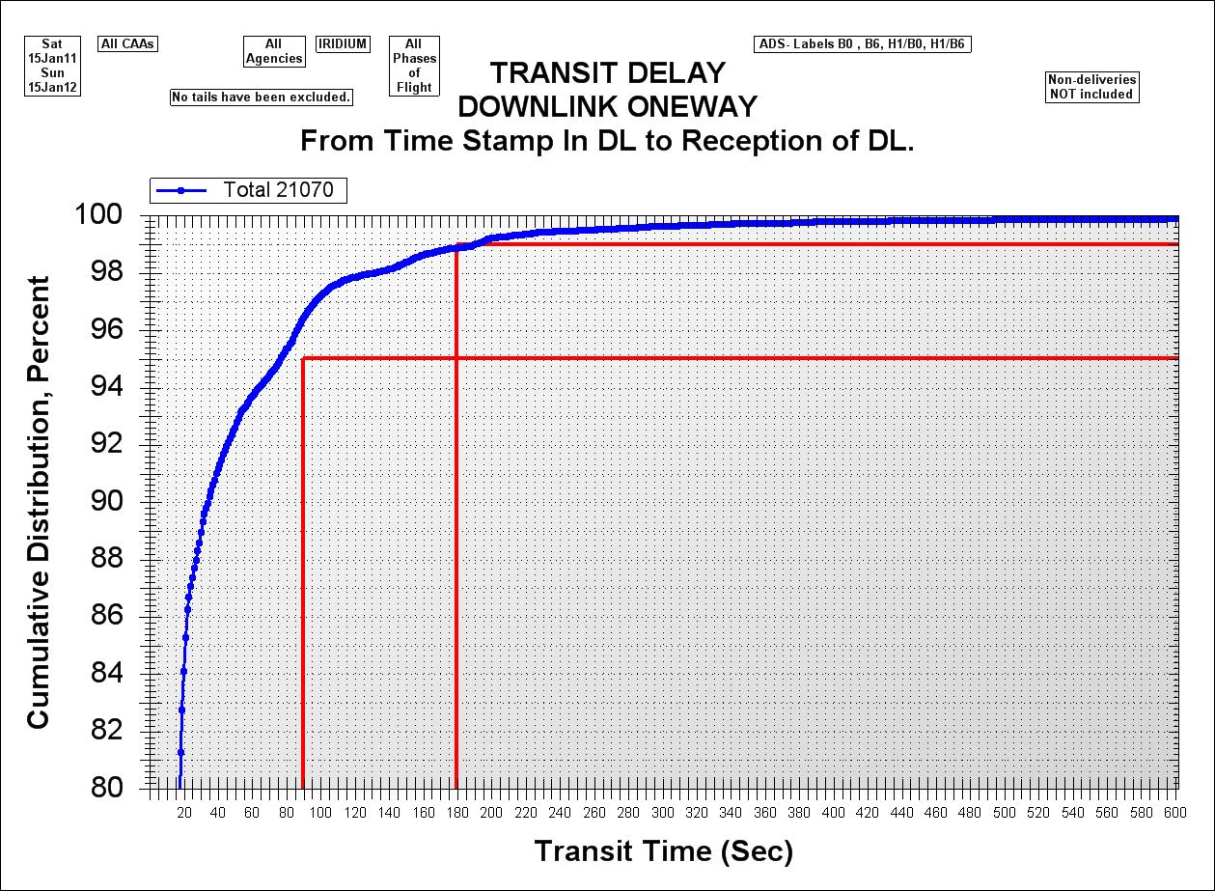
Long Range Communications – IRIDIUM (ADS)
Compared to the SATCOM services of I3 & I4, the data set is very small for the January 15, 2011 - January 15, 2012 time period.

Slide 14
Common Maintenance Reporting Procedure
ARINC receives notification from our vendor that an activity is going to take place or if we are performing an activity
ARINC fills out the template as shown below.
AAM
ARINC Advisory Message
We would like to inform you that ARINC maintenance work needs to be carried out according to the following:
Service(s):
Trouble Ticket/Change Order #:
Maintenance Location:
Maintenance Window:
Expected Outage Duration:
Description of Maintenance:
ARINC SERVICE DESK
US & INT'L ACCESS (Sprint) 1-800-633-6882 FAX 1-410-956-5465 HELPDESK@ARINC.COM HDQHDXA

Slide 15
Common Maintenance Reporting Procedure – Cont’d
ARINC Helpdesk forwards to the appropriate mailing list.
In some cases, Helpdesk is notified directly that a maintenance activity or outage is going to occur or is in progress. They will then automatically generate an advisory and send it out to the appropriate mailing lists.

Slide 16
Thank You

